Slide 1
Capstone Project
Face Emotion Recognition Self Project By Irshad

Slide 2
Contents
● Introduction
● Problem Statement
● Data Summary
● Dependencies
● Model Creation 1) Using DeepFace 2) Using Transfer Learning 3) Using CNN layers
● Loss & Accuracy Plot
● Real-time Local Video Face Detection
● Deployment of Streamlit WebApp in Heroku and Streamlit
● Various prediction Images from the WebApp
● Challenges
● Conclusions
● Some Real Life Learning from this Project

Slide 3
Introduction ● What is Face Emotion Recognition ? ● Why it is so important ? ● What is the scopes of Face Emotion Recognition?

Slide 4
Problem Statement The Indian education landscape has been undergoing rapid changes for the past 10 years owing to the advancement of web based learning services, specifically, eLearning platforms. Global E-learning is estimated to witness an 8X over the next 5 years to reach USD 2B in 2021. India is expected to grow with a CAGR of 44% crossing the 10M users mark in 2021. Although the market is growing on a rapid scale, there are major challenges associated with digital learning when compared with brick and mortar classrooms. One of many challenges is how to ensure quality learning for students. Digital platforms might overpower physical classrooms in terms of content quality but when it comes to understanding whether students are able to grasp the content in a live class scenario is yet an open-end challenge. In a physical classroom during a lecturing teacher can see the faces and assess the emotion of the class and tune their lecture accordingly, whether he is going fast or slow. He can identify students who need special attention. Digital classrooms are conducted via video telephony software program (ex-Zoom) where it’s not possible for medium scale class (25-50) to see all students and access the mood. Because of this drawback, students are not focusing on content due to lack of surveillance. While digital platforms have limitations in terms of physical surveillance but it comes with the power of data and machines which can work for you. It provides data in the form of video, audio, and texts which can be analyzed using deep learning algorithms. Deep learning backed system not only solves the surveillance issue, but it also removes the human bias from the system, and all information is no longer in the teacher’s brain rather translated in numbers that can be analyzed and tracked. I will solve the above-mentioned challenge by applying deep learning algorithms to live video data. The solution to this problem is by recognizing facial emotions.

Slide 5
Data Summary I have built a deep learning model which detects the real time emotions of students through a webcam so that teachers can understand if students are able to grasp the topic according to students' expressions or emotions and then deploy the model. The model is trained on the FER-2013 dataset . ● This dataset consists of 35887 grayscale, 48x48 sized face images with seven emotions - angry, disgusted, fearful, happy, neutral, sad and surprised.
emotion | number
0 | Angry | 4953
1 | Fear | 5121
2 | Sad | 6077
3 | Neutral | 6198
4 | Happy | 8989
5 | Surprise | 4002
6 | Digust | 547

Slide 6
Dependencies 1.Python 3 2.Tensorflow 2.0 3.Streamlit 4.Streamlit-Webrtc 5.OpenCV

Slide 7
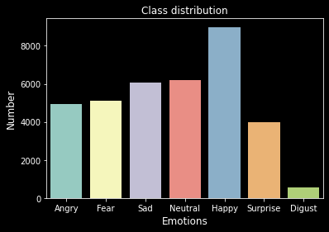
Plotting a bar graph of the class distributions
z

Slide 8
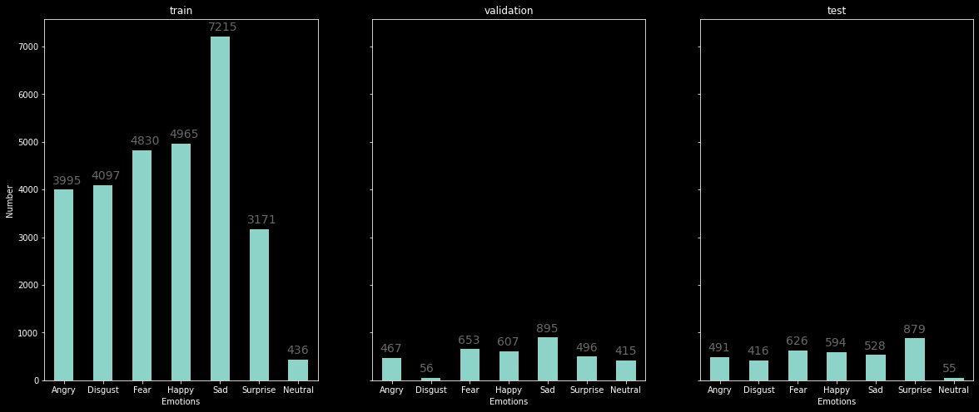
Barplot class distribution of train, val and test

Slide 9
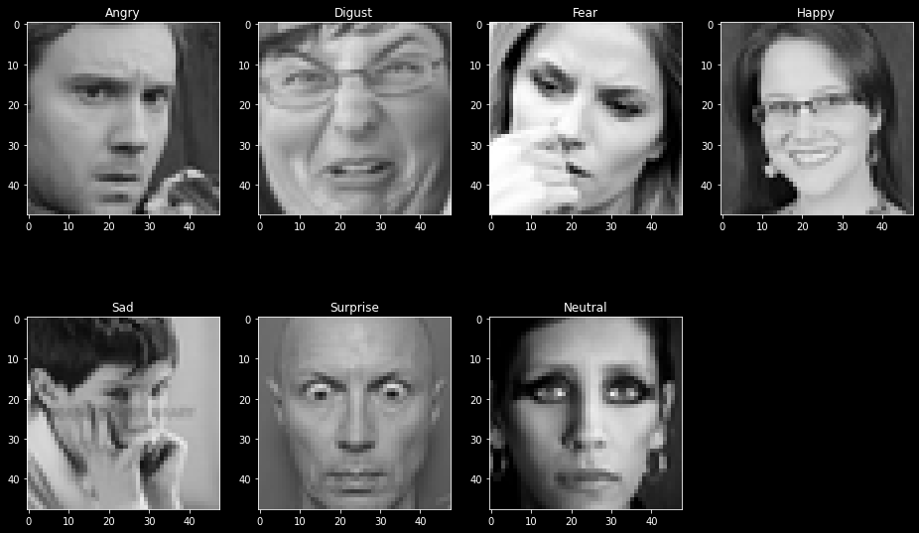
Model Creation 1) Using DeepFace What is DeepFace ?

Slide 10
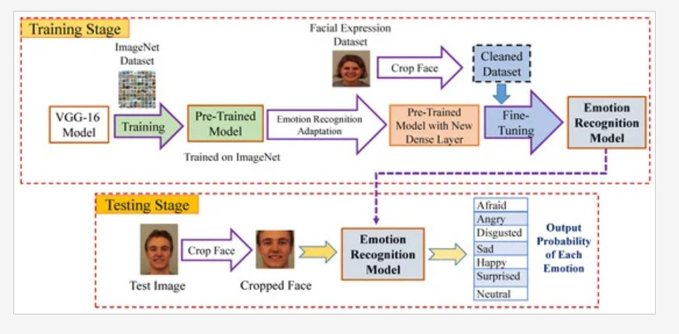
2) Using Transfer Learning What is Transfer Learning ?

Slide 11
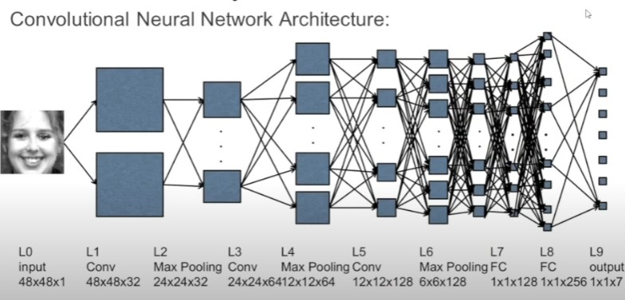
3) Using CNN layers What is CNN ?

Slide 12
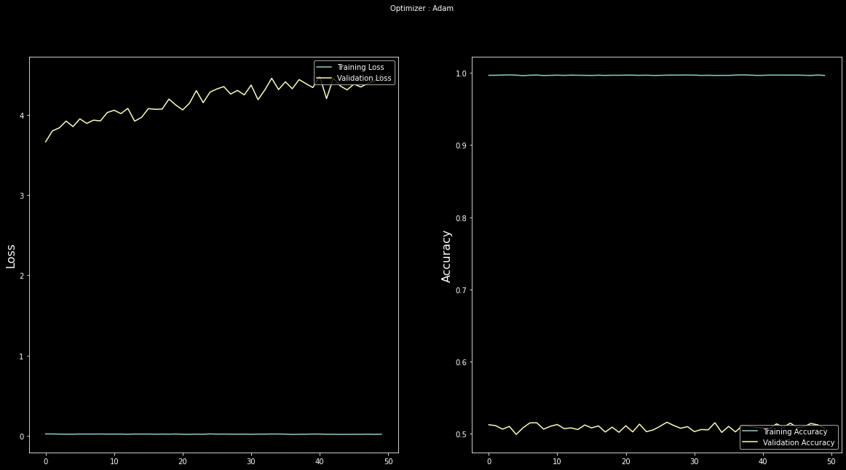
Loss & Accuracy Plot

Slide 13
Real-Time Local Video Face Emotion Detection I created two patterns for detecting and predicting single faces and as well as multiple faces using OpenCV videocapture in local. For Webapp , OpenCV can’t be used. Thus, using Streamlit-Webrtc for front-end application

Slide 14
Challenges • Large Image Dataset to handle. • Couldn’t able to connect GPU with Jupyter Notebook. • Tried creating lot of models till find the best one. • Continuous Runtime and RAM Crash due to large dataset. • Carefully tuned Hyper parameters .

Slide 15
Conclusion Finally I build the WebApp using streamlit and deployed in Heroku and Streamlit Sharing. • The model which was created by CNN layers gave training accuracy of 88% and test accuracy of 58.40% . • I have also included the video of my WebApp working in Local. • Codes which are deployed are in Github Repository. • It was such an amazing and interesting project. I learnt a lot from this.

Slide 16
Some Real Life Learning from this Project • Never Give Up. • Update yourself from your Failures. • A Scientist needs to overcome the failures. • Try existing all methods to reach the goal. • Have Patience and Good things take time to happen

Slide 17
THANK YOU Q & A

